Slide 1

VR-Gaming to Broad
Participation in CS 1.0
Team Members: Armando Carrasquillo, Daniel Perez, Santiago Bolivar Product Owner: Francisco Ortega
Instructor: Masoud Sadjadi School of Computing and Information Sciences Florida International University
Final Presentation
Spring 2018
Notes:
7 seconds.( I will select 2 best slides (i will give them extra points and students will present for CIS committee)
Greet your audience, thank them for attending your presentation, introduce yourself, introduce your project, introduce your team members, and quickly indicate what each of you did in a high-level manner, and put more emphasis on your part/contribution.

Slide 2
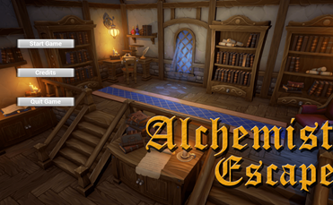
Project definition
Data has shown that Computer Science(CS) professionals are on high demand.
Unfortunately, data also shows that there is a low graduation rate, and low levels of interest from women and minorities
Notes:
10 seconds.
Introduce the problem that the whole project (in all versions) tackles with GIF or screenshot.

Slide 3
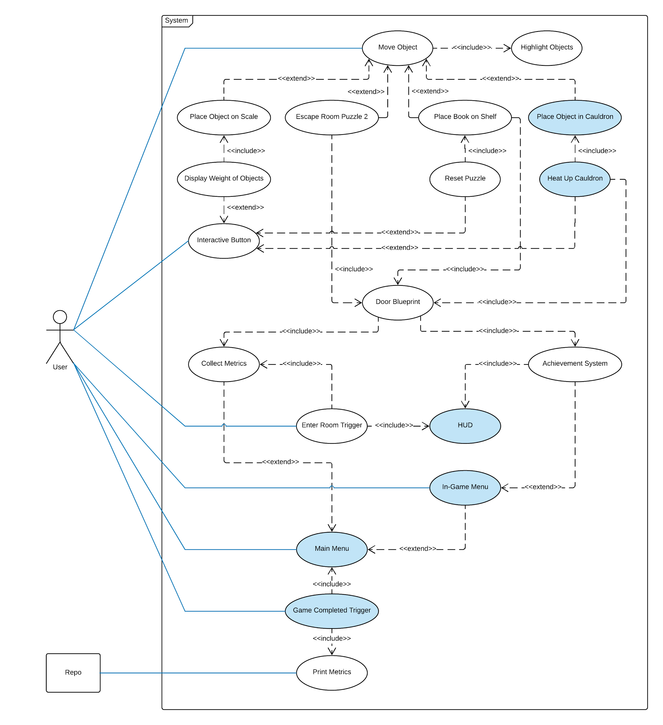
Requirements: Use Cases
Armando
Notes:
5 seconds
Show the Use Case Diagram for the whole project. Highlight your use cases.

Slide 4
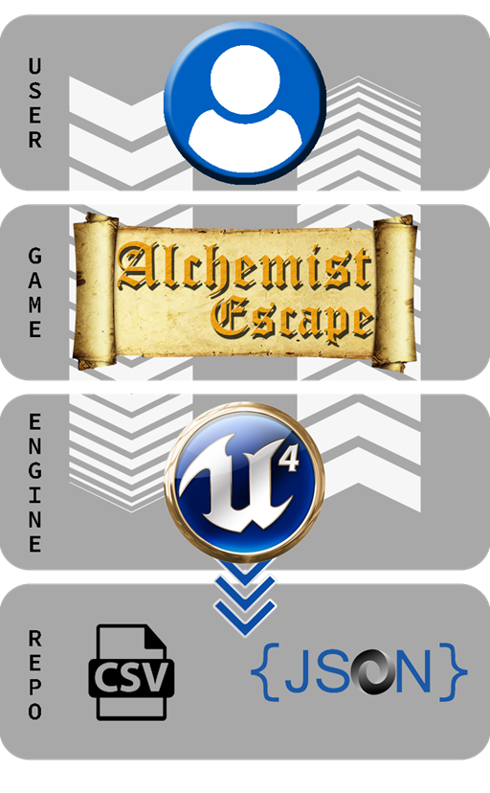
System Design: Architecture
Notes:
20 seconds
System design: Highlight the parts that you contributed to them.
1. System decomposition; identify the architecture patterns used
2. System deployment – h/w and s/w requirements

Slide 5
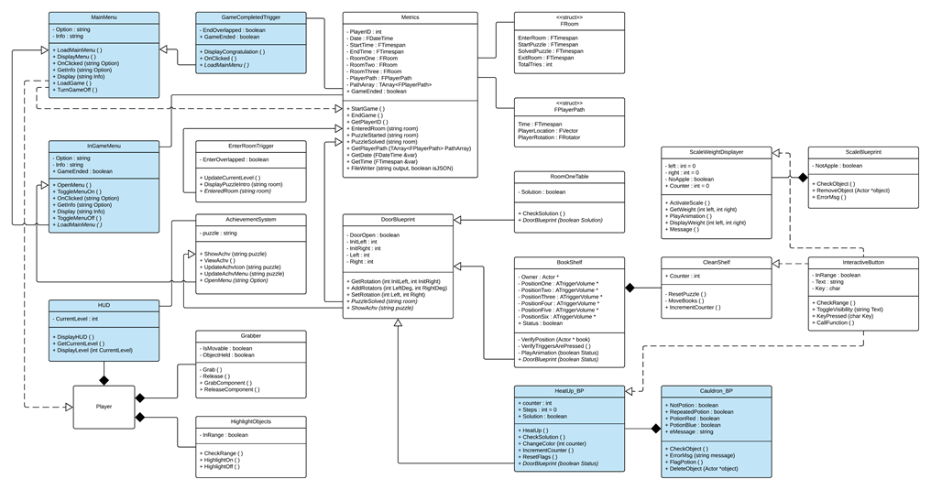
Minimal Class Diagram:
Armando’s Contributions
Notes:
10 seconds.Minimal class diagram. Highlight the classes that you created/modified
Identify the design patterns used (one or more slides).

Slide 6
User Stories:
Armando
1.Implement Adding Objects to Cauldron
2.Implement Interaction to Heat Up Cauldron
3.Implement In-Game Menu
4.Implement Main Menu
5.Create Game Completed Trigger
Notes:
5 seconds.
List the user stories that you worked on them.(put in order of importance). Stay focused on the parts that you have been working.

Slide 7
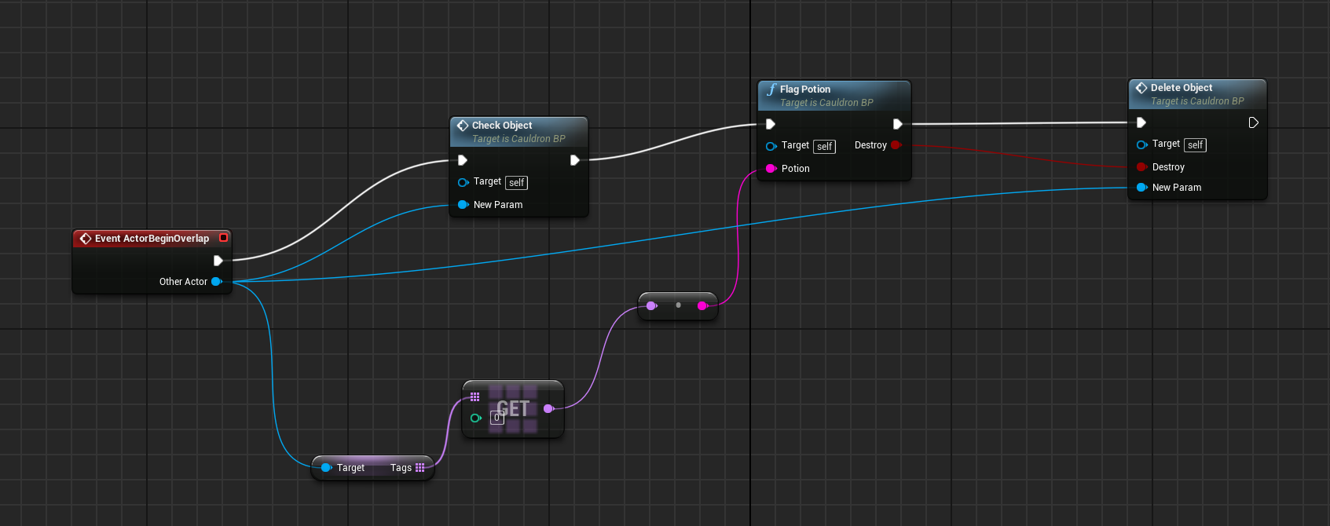
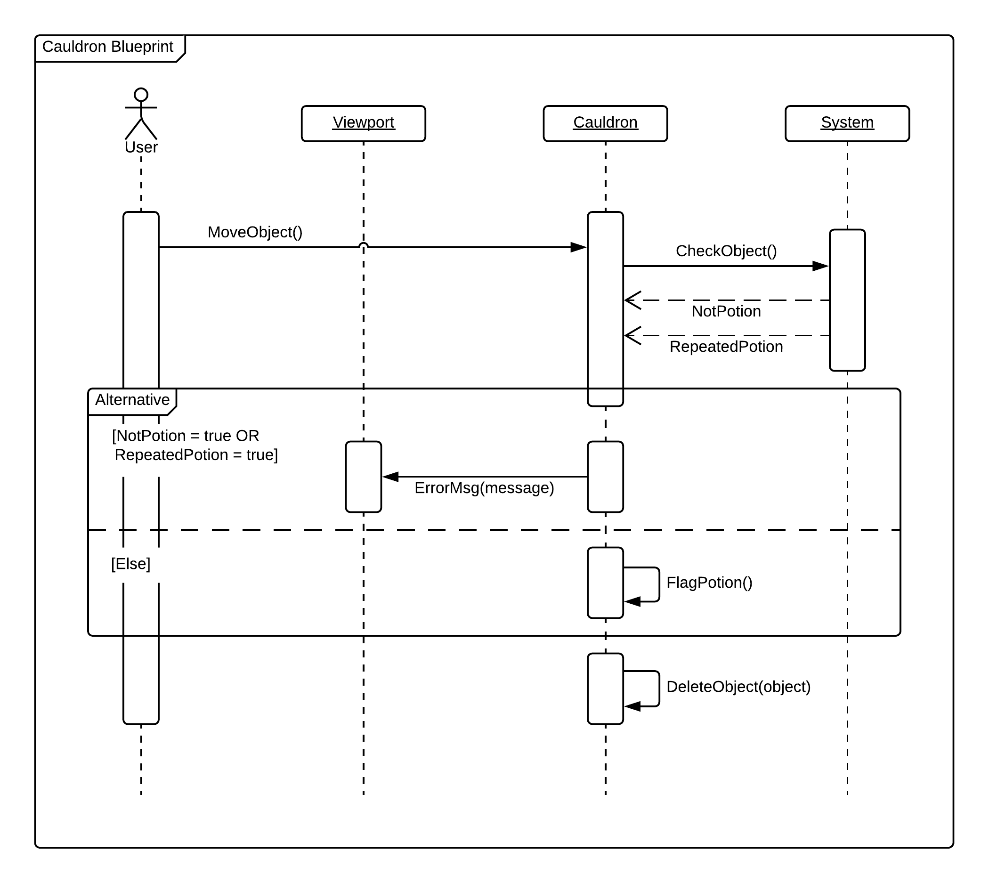
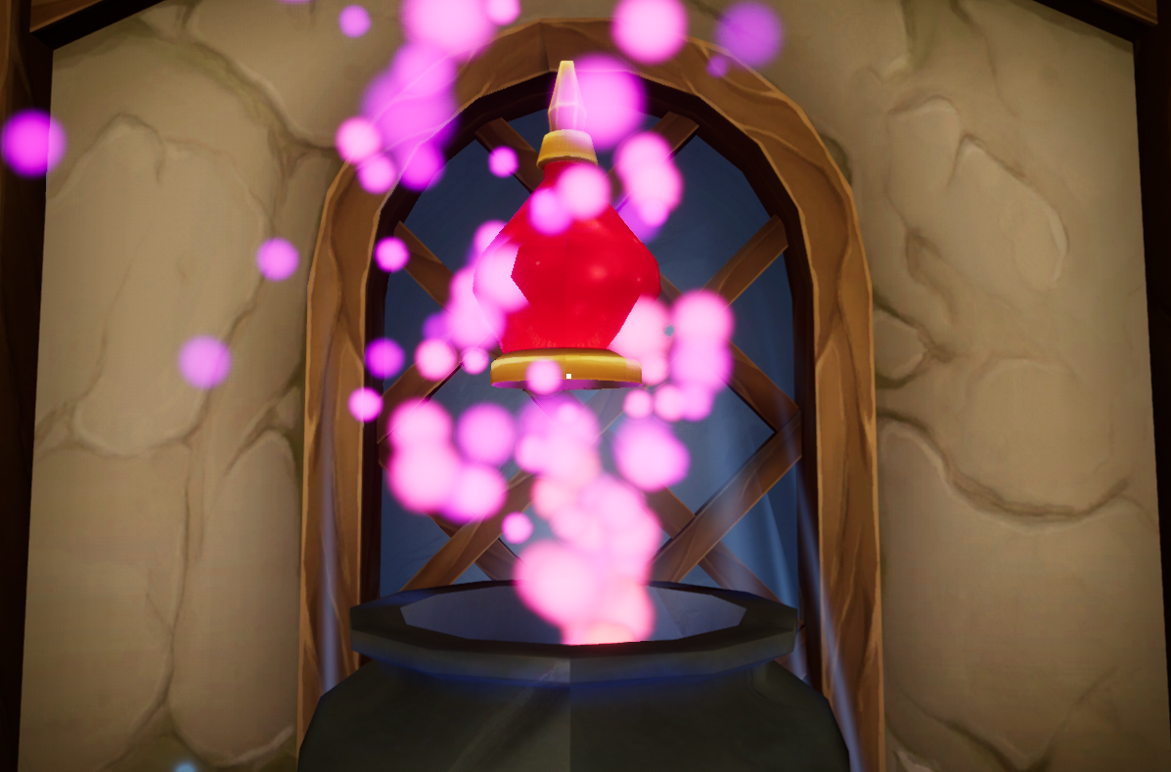
User Story #1:
Implement Adding Objects to Cauldron
Notes:
60 seconds
The tile of user story
The most important user story you worked on it. You have to describe this one very well and be proud of that.
Please present and show the complexity of your work, code, algorithms, and technical challenges and technologies you have used. (you could use screenshot if you want. Visual presentations are better than text presentation)
Go into the details of the most important/significant tasks using bullet lists or visual graphs or state chart diagram
Sequence Diagram for this user story is mandatory (in another separate page if required)
Demo using screenshots or GIF (in another separate page if required)

Slide 8
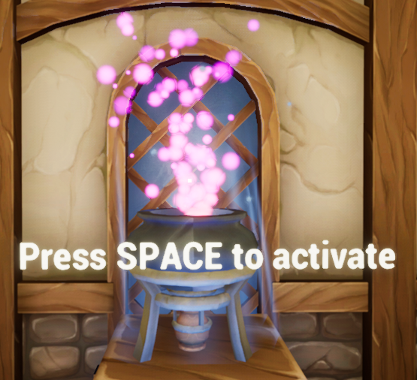
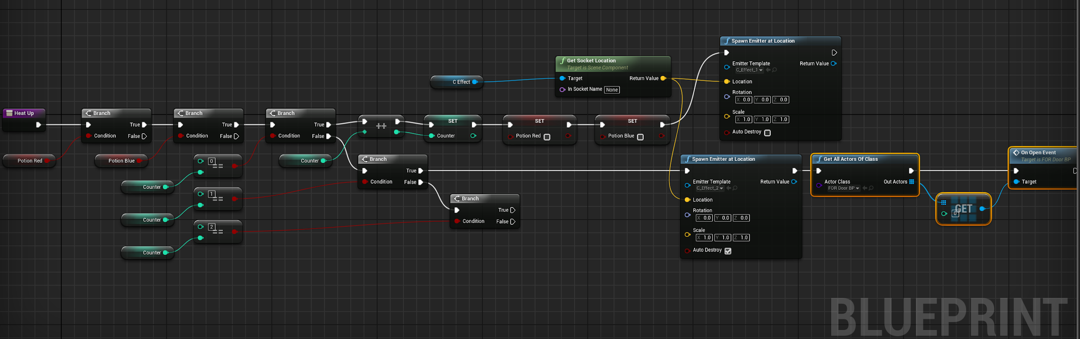
User Story #2:
Implement Interaction to Heat Up Cauldron
Notes:
20 seconds
The tile of user story
Please present and show the complexity of your work, code, algorithms, and technical challenges and technologies you have used. (you could use screenshot if you want. Visual presentations are better than text presentation) - Go into the details of the most important/significant tasks using bullet lists or visual graphs or state chart diagram - Demo using screenshots or GIF (in another separate page if required)
Sequence Diagram for this user story is optional

Slide 9
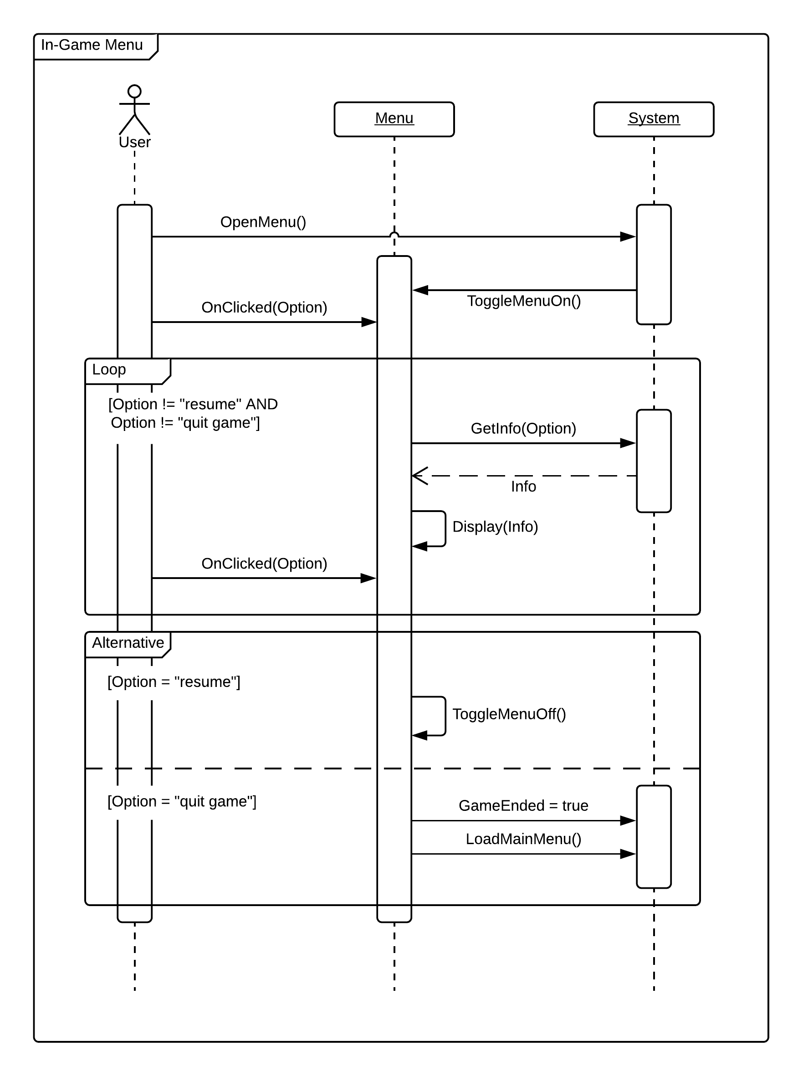
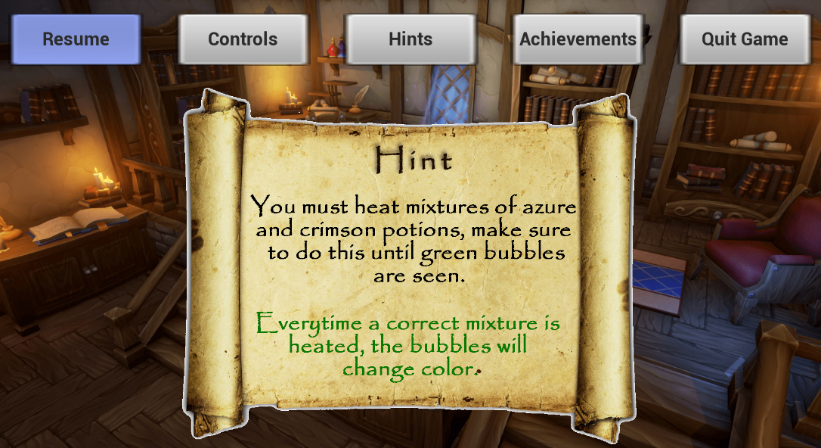
User Story #3:
Implement In-Game Menu
Notes:
20 seconds
The tile of user story
Please present and show the complexity of your work, code, algorithms, and technical challenges and technologies you have used. (you could use screenshot if you want. Visual presentations are better than text presentation) - Go into the details of the most important/significant tasks using bullet lists or visual graphs or state chart diagram - Demo using screenshots or GIF (in another separate page if required)
Sequence Diagram for this user story is optional

Slide 10
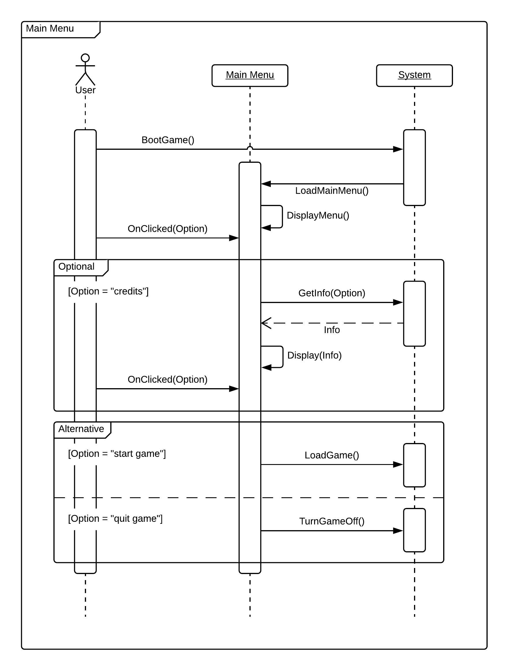
User Story #4:
Implement Main Menu
Notes:
20 seconds
The tile of user story
Please present and show the complexity of your work, code, algorithms, and technical challenges and technologies you have used. (you could use screenshot if you want. Visual presentations are better than text presentation) - Go into the details of the most important/significant tasks using bullet lists or visual graphs or state chart diagram - Demo using screenshots or GIF (in another separate page if required)
Sequence Diagram for this user story is optional

Slide 11
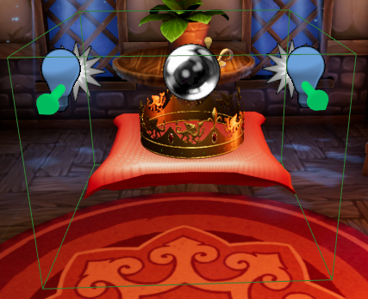
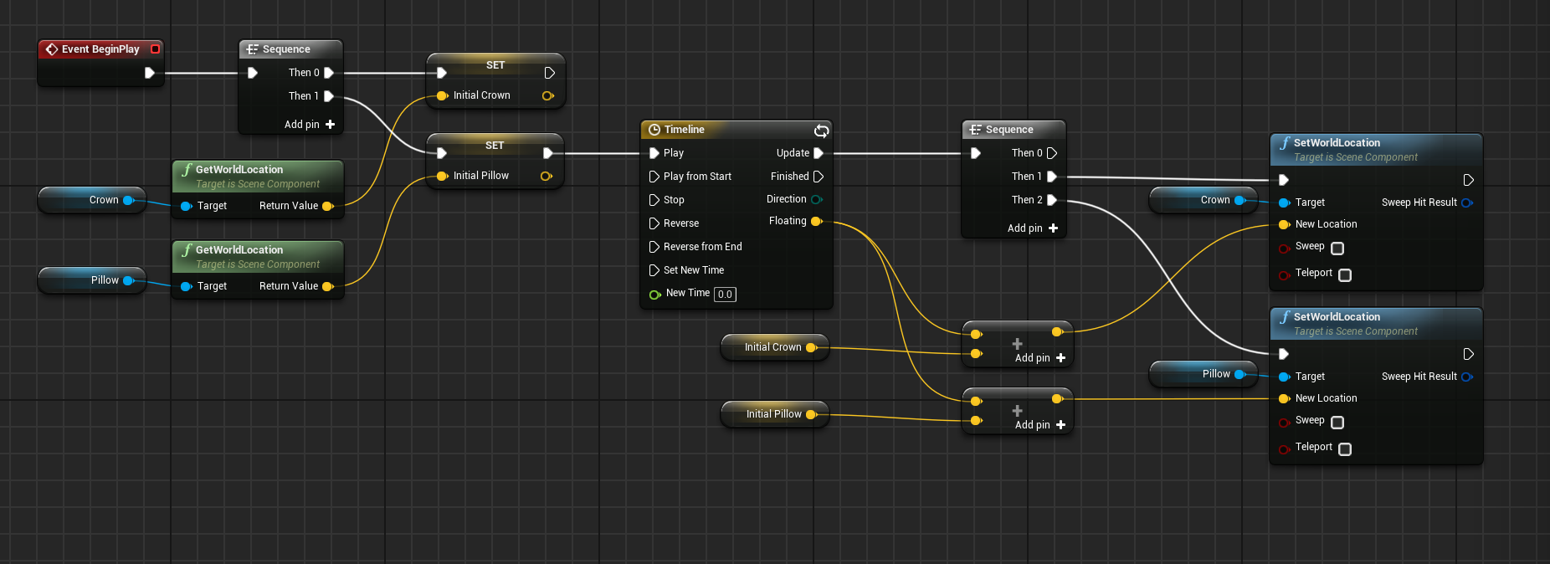
User Story #5:
Create Game Completed Trigger
Notes:
20 seconds
The tile of user story
Please present and show the complexity of your work, code, algorithms, and technical challenges and technologies you have used. (you could use screenshot if you want. Visual presentations are better than text presentation) - Go into the details of the most important/significant tasks using bullet lists or visual graphs or state chart diagram - Demo using screenshots or GIF (in another separate page if required)
Sequence Diagram for this user story is optional

Slide 12
Test Suites and Test Cases
Test case ID: check_solution_p1
Description/Summary of Test: Checks to see if the correct potions were placed in the Cauldron.
Pre-condition: Activate Heat Up button.
Expected Results: Checks to see if the correct potions were placed.
Actual Result: Checks to see if the correct potions were placed.
Status (Fail/Pass): Pass
Test case ID: notify_result_p1
Description/Summary of Test: Changes the particle effect on the Cauldron.
Pre-condition: Solution within cauldron is correct.
Expected Results: Changes particle effect within cauldron.
Actual Result: Particle effect changed.
Status (Fail/Pass): Pass
Notes:
10 seconds
A description of verification process and Test Suites and Test Cases for one of the use cases.
1 One sunny day and one rainy day for the implemented use cases (one or more slides).
2 Automated test scripts for the implemented use cases (if any) (one or more slides).

Slide 13





Summary
Summary
contact information: acarr009@fiu.edu
Questions?
Thank You!
Notes:
10 seconds
Summarize your contribution, mention your effort for Scrum, Mingle, Github, Google Drive Documentation and minutes
Include your contact information
Ask if anyone has any questions for you.
Thank your audience

